Slide 1


Maritime
Cyber Security Summer School - CyberHOT
CSP011_SA_M
PRESENTATION BY:
PROF. NINETA POLEMI
ASSOC. PROF. SOTIRIS IOANNIDIS

Slide 2


Slide 3



Goals: Who-What-Why you need to take this training
WHO
WHAT
WHY
Everyone with basic knowledge who is interested in maritime security
Maritime cyber ranges and operations for managers, leaders and working-professionals
Equipping participants with the knowledge and skills necessary to make a strategy to protect critical systems and data

Slide 4



CSP Training Logistic: When-Where-How
WHEN
WHERE
HOW
Time schedule: September 2024
ONSITE-Piraeus_Greece
Hands on Training

Slide 5

Value Propositions
Benefits to Participants
Level of Training Module: Advance
Cybersecurity Professional Training
Hands-on and Practical Skills Development
Rooted with European Cybersecurity Skills Framework
Cutting-edge insights from industry-academic experts
Certificate of the completion
Helps with skills development and career advancement

Slide 6

WHO
Profile of Training Participants
Managers and Leaders
Working-life professionals
SMEs and Public Sector Employees
Cybersecurity practitioners and enthusiasts

Slide 7

WHO
Profiles of Trainers
Nineta Polemi is a cybersecurity Professor in the University of Piraeus-UNIPI- (Cyber Security Lab, Dept. of Informatics) and CTO/ Co-Founder of Trustilio. She served (2017-2020) as Programme Manager and Policy Officer in the European Commission DG (CONNECT H1 Unit entitled ’Cybersecurity Technologies and Capabilities’). She has obtained her Ph.D. in Applied Mathematics (Coding Theory) from The City University of New York (Graduate Center). She held teaching and research positions in The City University of New York (Queens & Baruch Colleges), State University of New York (Farmingdale), Université Libre de Bruxelles (ULB)-Solvay Brussels School-. She has over 150 publications in security (e.g. port security, maritime security, maritime supply chain security) has organised numerous scientific and policy international cybersecurity scientific events. She has received many research grants (NATO, IEEE) and awards (NSA, MSI Army Research Office IEEE, CYNY, Hellenic Ministry of Maritime, Hellenic National Defense General) and has participated as Project and Technical Manager in more than 60 cybersecurity international, EU and national R&D and commercial projects. She serves as external expert/reviewer/consultant in ENISA, E.C.(DG CNECT, DG HOME), FORTH, Focal Point.
Prof. Sotiris Ioannidis received a BSc degree in Mathematics and an MSc degree in Computer Science from the University of Crete in 1994 and 1996 respectively. In 1998 he received an MSc degree in Computer Science from the University of Rochester and in 2005 he received his Ph.D. from the University of Pennsylvania. Ioannidis held a Research Scholar position at the Stevens Institute of Technology until 2007 and a Research Director at the Foundation for Research and Technology – Hellas (FORTH) until 2020. He is currently Associate Professor at the School of Electrical and Computer Engineering of the Technical University of Crete (TUC) and Director of the Microprocessor and Hardware Laboratory. He was a Member of the ENISA Advisory Group (AG) from 2017 to 2020, and is a Member of the National Infrastructures for Research and Technology (GRNET) Advisory Committee (AC). He is also Chairman of the of the Committee of Ethics and Deontology of Research of FORTH and Member of the Advisory Committee for National Infrastructures for Research and Technology. His research interests are in the area of systems and network security, security policy, privacy, and high-speed networks. Ioannidis has authored more than 200 publications in international conferences and journals, as well as book chapters, and has both chaired and served on numerous program committees in prestigious conferences, such as ACM CCS and IEEE S&P. Ioannidis is a Marie-Curie Fellow and has been the PI of more than 40 European, National, and DARPA funder projects.

Slide 8

WHAT
Training Topics
Introduction to Cyber Security and Ethical Hacking
Risk Management and Incident Handling in Cyber Security
Sector-specific Cybersecurity Challenges (Maritime)
Red-Teaming Methodologies and Tools
Penetration Testing Concepts and Tools
Cyber Threat Intelligence Basics
Enumeration Techniques for Web Services
Researching Vulnerabilities in Known Components
Exploiting Vulnerabilities with Metasploit and Public Exploits
Implementing Privilege Elevation on Compromised Targets

Slide 9

WHY
Learning Outcomes
Develop advanced technical skills in various aspects of Cyber Security
Gain expertise in ethical hacking and penetration testing
Acquire knowledge and capabilities in risk management and incident handling
Understand sector-specific cybersecurity challenges in maritime, health, and energy industries
Implement red-teaming methodologies and tools effectively
Enhance skills in Cyber Threat Intelligence
Perform enumeration on web services
Research vulnerabilities in known components
Exploit existing vulnerabilities using tools like Metasploit and public exploits
Implement privilege elevation on compromised targets

Slide 10

Training Outline
Day-1
Topic-1: Introduction to HtB (Hack the Box) platform - Penetration Testing Walkthroughs 1
Basic Windows knowledge
Port and Service Enumeration
Exploit Modification
Metasploit
Topic-2: Penetration Testing Walkthroughs 2
Linux
Port Scanning and Enumeration
Web Fuzzing
Locating Recently Modified Files

Slide 11
Training Outline
Day-1
Topic-3: Capture the Flag, Penetration Testing Exercise
Challenge 5 Highlights:
§ Python
§ Linux
§ XXE Injection
§ Source Code Review
Challenge 6 Highlights:
§ Enumeration
§ Exploit Development
§ ROP
§ Cracking keepass databases
Challenge 7 Highlights:
§ Enumeration
§ SQL Injection
§ Java Classes
§ Debugging with JDWP
§ Speech to Text

Slide 12

Topic: Ethical Penetration Testing
We will cover these skills
Understanding of Cyber Threat Intelligence (CTI): This involves grasping basic concepts and challenges related to Cyber Threat Intelligence, which is crucial for effective risk management and cybersecurity strategies.
Familiarity with Risk Assessment, Red Teaming, and Penetration Testing Tools: This includes gaining practical knowledge of popular tools used in risk assessment, red teaming, and penetration testing. These tools are essential for identifying vulnerabilities and assessing security posture.
Knowledge of Risk Management and Penetration Testing Methodologies: Understanding the fundamental steps involved in risk management and penetration testing methodologies is vital for conducting thorough assessments and implementing effective security measures.
Practical Experience in Hack the Box Labs: This involves hands-on experience in using the Hack the Box platform, specifically in dedicated labs where participants can launch their own instances of attacker and target machines. This practical exposure helps in developing skills related to real-world cybersecurity scenarios, such as exploiting vulnerabilities and defending against attacks.

Slide 13


Training Practical Exercises
Practical exercises requiring both personal and team effort
The exercises change each year and are conducted in groups as part of the workshop training.

Slide 14

Evaluation method
Outline the evaluation elements and assessment process
Evaluation Element | How | Notes
Applied Tasks (Individual) | Problem solution during workshop
Teamwork | Team members to collaborate during workshop
Group discussion | During workshop

Slide 15

Background Knowledge and Prerequisites
Background knowledge:
Basic understanding of computers and networking
Familiarity with common internet security threats and vulnerabilities
Awareness of cybersecurity
Windows internals
_{Prerequisites:}
None

Slide 16

Technical Tools and Other Requirement
Technical Tools
Computer with Internet Access
Technical Tools: Kali Linux (Nmap), Sqlmap, Hydra, BurpSuite, Owasp-zap, Metasploit
_{Other Requirements}
Knowledge of Basic Computer Concepts / Awareness of Internet Security Practices / Willingness to Learn and Experiment / Active Participation

Slide 17

Resources: Books and Reference Material
ENISA. (2019). Good Practices for Cybersecurity in the Maritime Sector. Drougkas, A., Sarri, A., Kyranoudi, P., Zisi, A.
ENISA. (2023). ENISA Transport Threat Landscape. Theocharidou, M., Stanic, Z., Drougkas, A., De Sousa Figueiredo, R., Tsekmezoglou, E., Naydenov, R., Lella, I., Malatras, A.
Police warning after drug traffickers' cyber-attack. Available at: https://www.bbc.com/news/world-europe-24539417
The Untold Story of NotPetya, the Most Devastating Cyberattack in History. Available at: https://www.wired.com/story/notpetya-cyberattack-ukraine-russia-code-crashed-the-world/
Troubled waters: Cyber-attacks on San Diego and Barcelona’s ports. Available at: https://darktrace.com/blog/troubled-waters-cyber-attacks-on-san-diego-and-barcelonas-ports
CyBOK (2021). "Web & Mobile Security Knowledge Area” Version 1.0.1.
NIST Special Publication 800-115. Technical Guide to Information Security Testing and Assessment.
OWASP Top 10:2021. Available at: https://owasp.org/Top10/
Synopsys. OWASP Top 10 2021. Available at: https://www.synopsys.com/glossary/what-is-owasp-top-10.html#A

Slide 18

Registration: How to register and other practical information
The specific registration process for the Cybersecurity Essentials and Management training may vary depending on the training provider or institution. However, the general steps are typically straightforward and can be completed online or in person.
Online Registration
In-Person Registration
Additional Practical Information

Slide 19
Course progress
o1.
Maritime Cybersecurity Risk Profile
o2.
Web Security
o3.
Windows Security
o4.
Penetration Testing

Slide 20
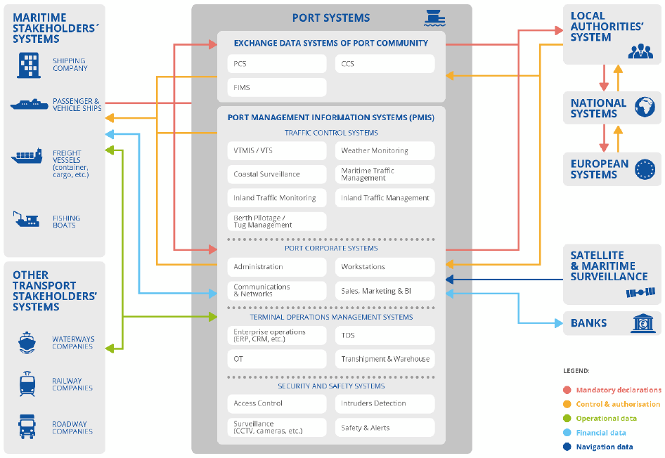
Maritime cybersecurity risk profile
Port Systems

Slide 21
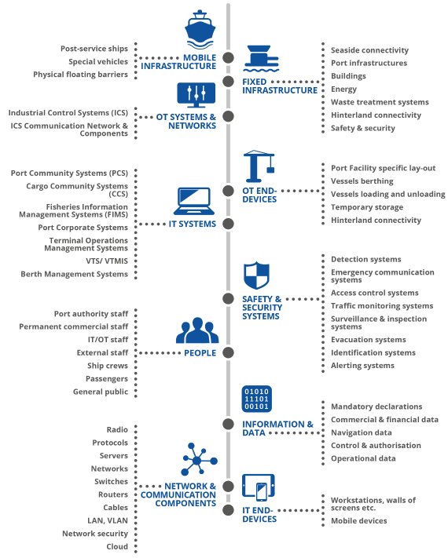
Maritime cybersecurity risk profile
Port Asset Taxonomy

Slide 22
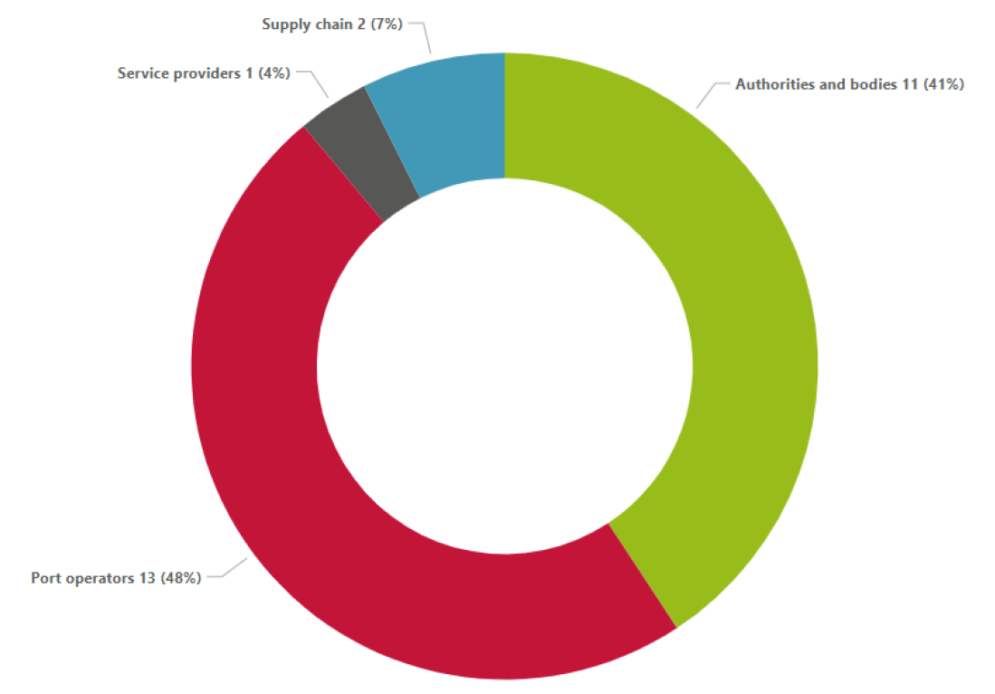
Maritime cybersecurity risk profile
Maritime Targets

Slide 23
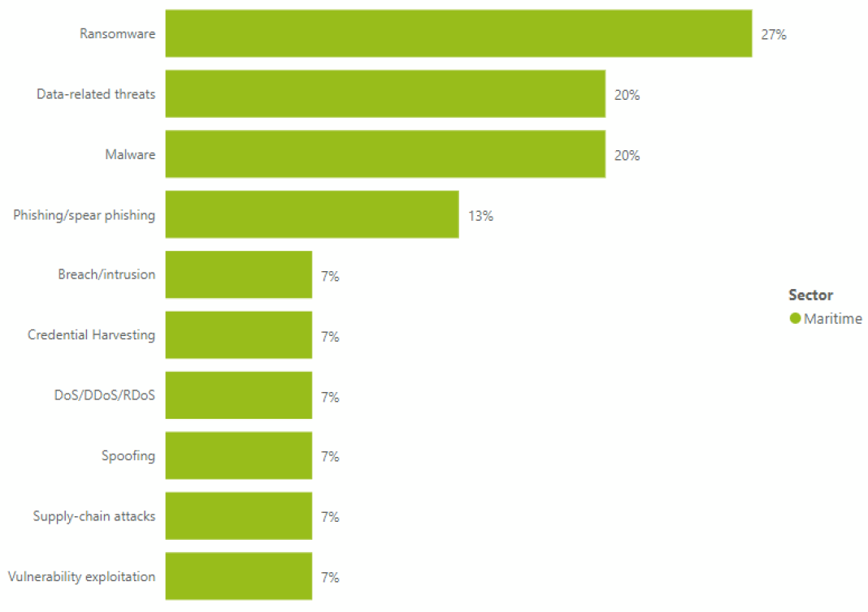
Maritime cybersecurity risk profile
Maritime
Prime Threats

Slide 24
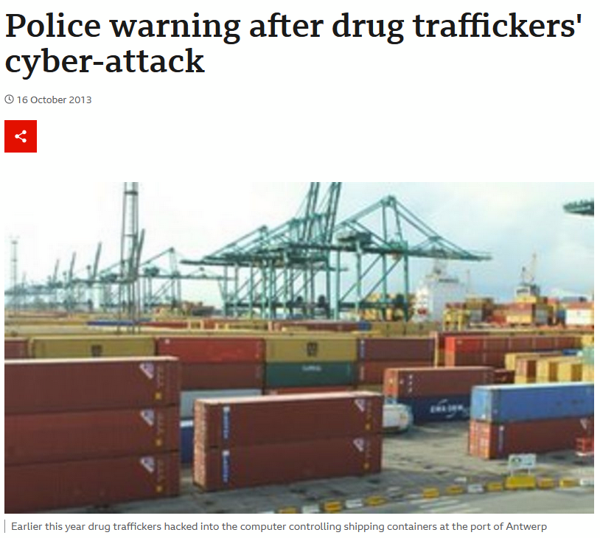
Maritime cybersecurity incidents
"In this case they hired hackers [who were] very high level, intelligent guys, doing a lot of software work," he adds.
He says the operation to hack the port companies took place in a number of phases, starting with malicious software being emailed to staff, allowing the organised crime group to access data remotely.
When the initial breach was discovered and a firewall installed to prevent further attacks, hackers broke into the premises and fitted key-logging devices onto computers.
This allowed them to gain wireless access to keystrokes typed by staff as well as screen grabs from their monitors.

Slide 25
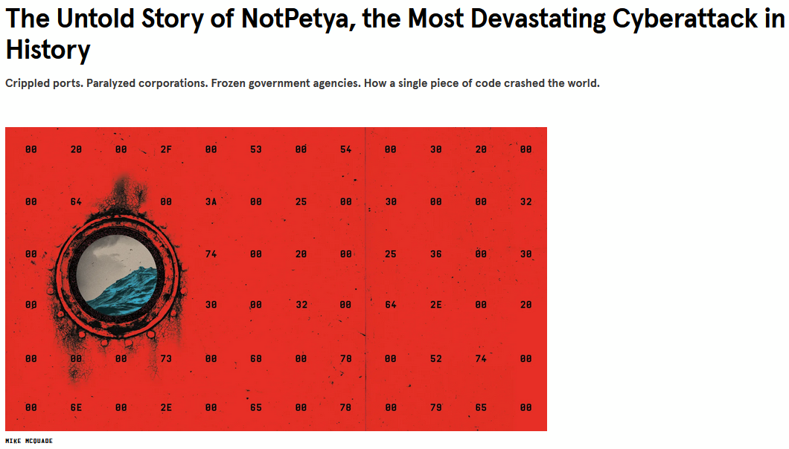
Maritime cybersecurity incidents
Jensen looked up to ask if anyone else in his open-plan office of IT staffers had been so rudely interrupted. And as he craned his head, he watched every other computer screen around the room blink out in rapid succession.
“I saw a wave of screens turning black. Black, black, black. Black black black black black,” he says. The PCs, Jensen and his neighbors quickly discovered, were irreversibly locked. Restarting only returned them to the same black screen.
[...] NotPetya’s architects combined that digital skeleton key with an older invention known as Mimikatz, created as a proof of concept by French security researcher Benjamin Delpy in 2011. Delpy had originally released Mimikatz to demonstrate that Windows left users’ passwords lingering in computers’ memory. Once hackers gained initial access to a computer, Mimikatz could pull those passwords out of RAM and use them to hack into other machines accessible with the same credentials. On networks with multiuser computers, it could even allow an automated attack to hopscotch from one machine to the next.

Slide 26
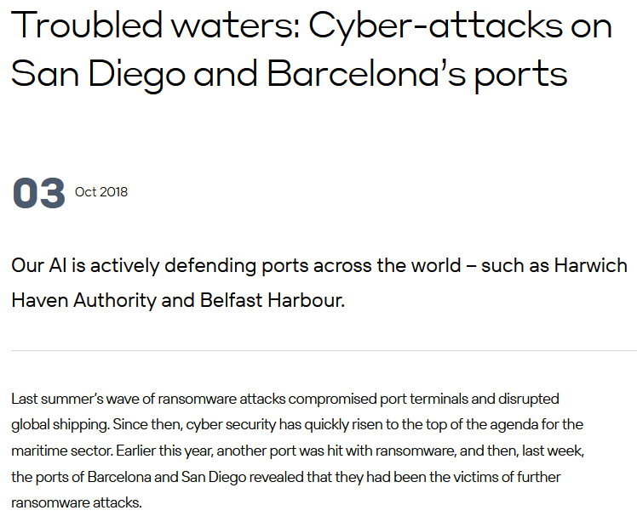
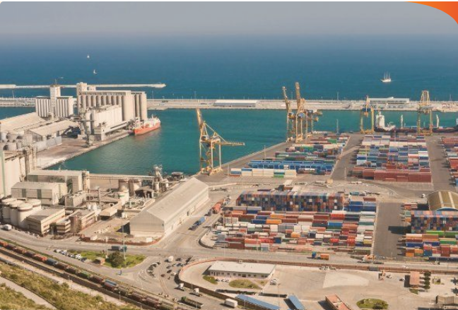
Maritime cybersecurity incidents
The increasing convergence of IT and OT systems shows no signs of slowing, however. Hyper-connected ‘smart’ ports are bringing efficiency and precision while cutting costs. Yet, the intertwining of the physical and digital across ports remains a significant challenge for the cyber security teams tasked with their defense. Without rushing to conclusions, it is perhaps no surprise that the Port of Barcelona is in the process of a “Digital Port project,” launched last year to promote the digitization of the port environment.

Slide 27
Port security measures classification
Policies
Organisational practices
Technical practices
  Network security
  Access control
  Administration and Configuration Management
  Threat management
  Cloud security
  Machine-to-machine security
  Data protection
  Update management
  Detection and monitoring
  Industrial control systems security
  Backup and restore

Slide 28
Course progress
o1.
Maritime Cybersecurity Risk Profile
o2.
Web Security
o3.
Windows Security
o4.
Penetration Testing

Slide 29
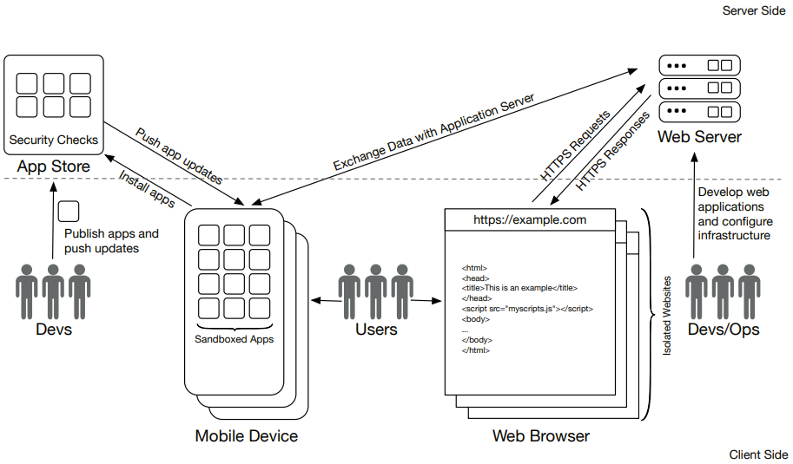
Web Security
Web and
Mobile
Ecosystem

Slide 30
Web Security
Common technologies of the web
Uniform Resource Locators (URLs)
Hypertext Transfer Protocol (HTTP)
Hypertext Markup Language (HTML)
Cascading Style Sheets (CSS)
JavaScript
WebAssembly
WebViews

Slide 31
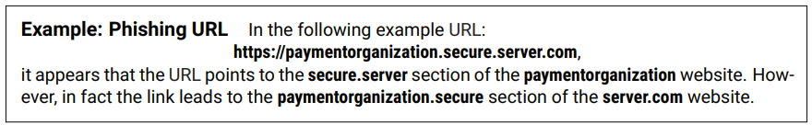
Web Security
Client side vulnerabilities & attacks
Phishing
The attacker pretends to be trustworthy by sending authentic-like fake emails, websites, or messages in order to to steal sensitive information, including login credentials and/or card data.
e.g.: Drive-by-download Attacks:
happen when visiting a malicious website / click on a malicious link / attachment / popup window
download and install malware
detection approach example: anomaly or signature based malware detection
Clickjacking
The attacker alters the visual presentation of a webpage in order to deceive users into interacting with a fake/malicious link, button, or image.

Slide 32
Web Security
Client side vulnerabilities & attacks
Client Side Storage
The areas provided by a browser or operating system for websites or mobile apps to read and write data. This storage is specific to the user's device and does not rely on server resources or an online connection.
Risk: malicious user may manipulate stored information.
Solution: client-side storage areas need to be protected from malicious access.
e.g.: Common client-side storage areas:
in the browser
in mobile apps

Slide 33
Web Security
Server side vulnerabilities & attacks
Injection Vulnerabilities
When applications lack proper validation of user input, allowing attackers to inject code into the application's control flow.
e.g.: Common injection vulnerabilities:
SQL injection
Command injections
User uploaded files
Local file inclusion
Cross-site scripting (XSS)
Cross-site request forgery

Slide 34
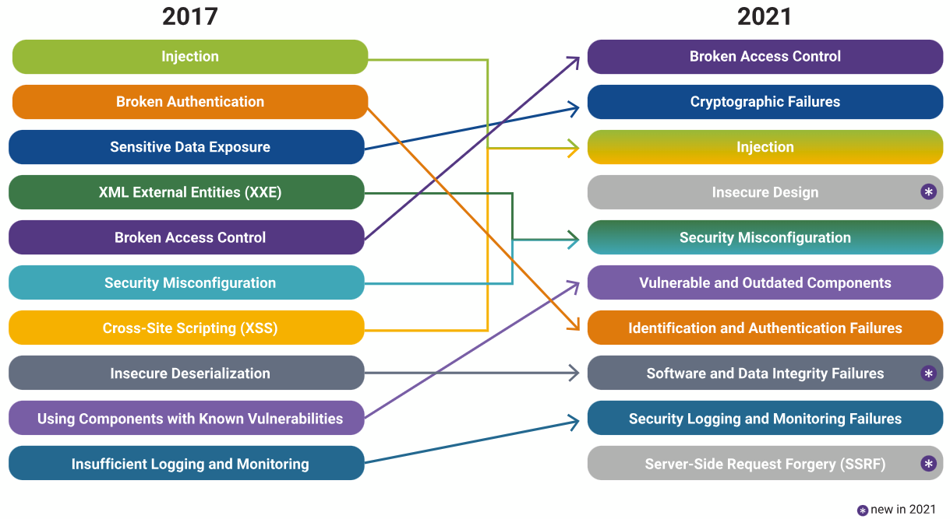
OWASP top 10 most critical web application security risks
OWASP Top 10:2024: https://www.owasptopten.org

Slide 35
Course progress
o1.
Maritime Cybersecurity Risk Profile
o2.
Web Security
o3.
o3.
Windows Security
o4.
o4.
Penetration Testing

Slide 36
Windows security
Understanding AppLocker: Enhancing Windows Security
Definition: AppLocker is a feature in Windows that helps you control which applications and files users can run. It includes executable files, scripts, Windows Installer files, DLLs, and packaged apps.
Purpose: Designed to increase the security of your organization by only allowing trusted applications to run, significantly reducing the risk of malware and unauthorized software usage.
Evolution: Successor to Software Restriction Policies (SRP), offering more granular control and easier management.
The Significance of AppLocker in Modern Security Practices
Beyond Antivirus: Explains the limitations of traditional antivirus solutions in detecting new or modified malware and how AppLocker provides an additional layer of defense.
Proactive Control: AppLocker's whitelist approach ensures that only approved applications can execute, preventing the execution of unknown or malicious software.
Security Strategy: Integrates with the overall security strategy to provide comprehensive protection against complex cyber threats.

Slide 37
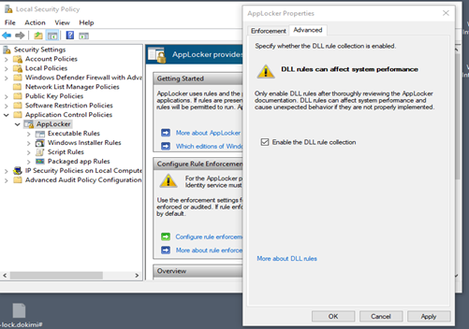
Windows security
Key Features and Capabilities of AppLocker
Flexible Rule Creation: Allows the creation of rules based on file attributes like publisher name, file hash, and path. Enables precise control over application execution.
User and Group Targeting: Rules can be applied universally or tailored for specific users or groups, enhancing security without hindering productivity.
Audit and Enforcement Modes: Supports testing AppLocker rules in a real-world scenario without impacting user operations, through audit-only mode before full enforcement.
Automated Rule Management: Utilizes PowerShell cmdlets for creating, managing, and troubleshooting AppLocker rules, streamlining administrative tasks.

Slide 38
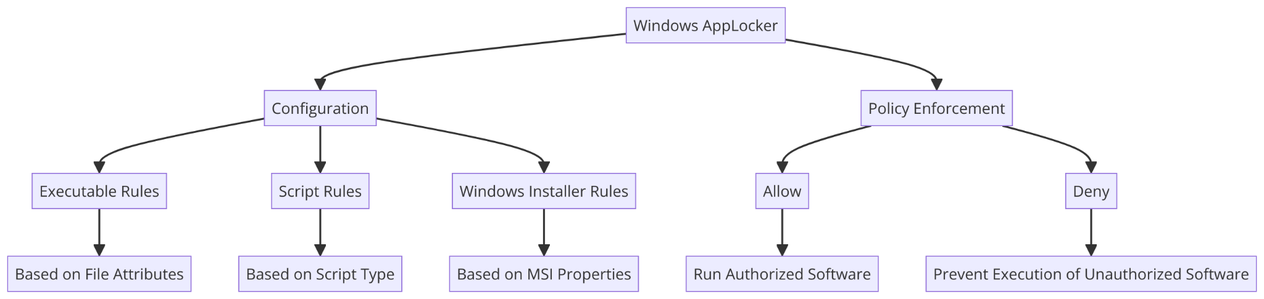
Windows security
Rules
Approach: Start by identifying and approving known, trusted applications. Implement default rules to ensure system functionality.
Rule Types: Overview of the different rule types (Executable, Script, Installer, Packaged App, DLL) and their purposes.
Default Rules: Importance of default rules for allowing essential Windows operations and ensuring that administrators can run all applications.
Types
Publisher Rules: Based on digital signatures to verify an application’s authenticity. Ideal for commonly updated applications as it remains valid across updates.
Path Rules: Specify directories or paths from which applications can run. Useful for controlling access to applications stored in known locations.
File Hash Rules: Utilize cryptographic hashes to uniquely identify files. Best for applications that seldom change, as any update requires rehashing

Slide 39
Windows security
Managing AppLocker
Enforce vs. Audit Only: The importance of starting with Audit Only mode to assess the impact of rules before enforcing them, minimizing disruption.
Exceptions: How to define exceptions within rules to allow specific applications while broadly blocking others, offering nuanced control.
Wizards: Utilizing AppLocker's built-in wizards for rule creation simplifies the process of setting up rules for different application types
Deploying AppLocker
Rule Priority: Understanding the precedence of deny over allow actions and how exceptions can refine access controls.
Regular Updates: The necessity of updating rules following application updates, especially for hash-based rules.
Comprehensive Coverage: Ensuring all executable types are covered by AppLocker rules to prevent unauthorized execution.

Slide 40
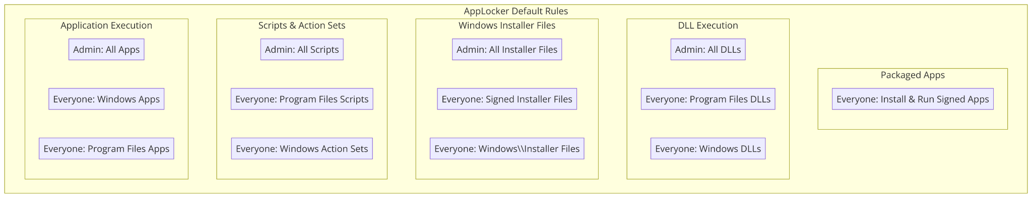
Windows security
AppLocker default rules

Slide 41
Windows security
Addressing AppLocker Challenges in Maritime Settings
Network Connectivity: Strategies for managing AppLocker rules in environments with intermittent connectivity, such as ships at sea.
Limited IT Resources: Solutions for deploying and managing AppLocker with minimal on-board IT support, leveraging remote management tools.
Maritime Software Compatibility: Ensuring essential maritime navigation and operation software are whitelisted and unaffected by AppLocker policies.
Enhancing Maritime Security Through Application Control
Layered Defense: The role of AppLocker in protecting maritime operational technology (OT) and information technology (IT) systems from unauthorized software and malware.
Compliance and Regulation: Assisting maritime organizations in complying with international maritime cybersecurity standards and regulations by controlling application execution.
Scenario Planning: Preparing for and mitigating cybersecurity incidents in maritime environments by restricting application execution to a vetted list.

Slide 42
Windows security
Deploying AppLocker on Vessels and at Port Facilities
Custom Rule Sets for Vessels: Developing AppLocker policies tailored to the specific software ecosystems of different classes of vessels.
Port Facility Considerations: Implementing AppLocker in port IT systems to protect against threats from USB drives and other removable media used in logistics and cargo management.
Training Crew and Staff: Importance of training maritime personnel on the reasons behind and the practices of application control to ensure compliance and minimize operational disruptions.
Advanced AppLocker Strategies for Maritime Operations
Proactive Protection: Emphasizing the role of AppLocker in preemptively securing maritime IT and OT environments against unauthorized applications and potential malware.
Adaptability: The importance of maintaining adaptable and up-to-date AppLocker policies to reflect the dynamic nature of maritime operations and software landscapes.
Security Culture: The critical role of fostering a security-aware culture among maritime personnel, supported by tools like AppLocker to enforce cybersecurity best practices.

Slide 43
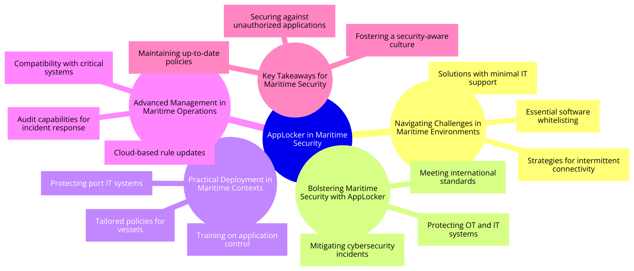
Windows security

Slide 44
Course progress
o1.
Maritime Cybersecurity Risk Profile
o2.
Web Security
o3.
Windows Security
o4.
Penetration Testing

Slide 45
Penetration testing
Definition
Penetration testing, commonly referred to as pen testing, is an authorized simulated cyberattack on a computer system, network, or application to evaluate the security of the system. The process involves identifying vulnerabilities that could be exploited by malicious hackers and assessing the potential impact of such vulnerabilities. Penetration testing aims to uncover security weaknesses and assess the effectiveness of existing security measures, helping organizations improve their overall security posture.

Slide 46
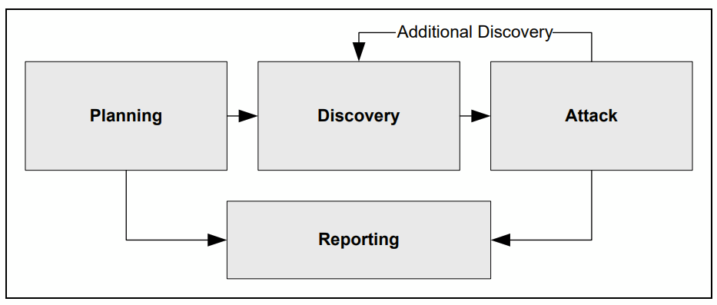
Four-stage penetration testing methodology

Slide 47
Four-stage penetration testing methodology
Planning phase: rules identification, management approval finalization and documentation, testing goals setting.
Discovery phase:
  information gathering and scanning - port and service identification, host name and IP address information (DNS interrogation, WHOIS queries, network sniffing), employee names and contact information (organisation’s Web or directory servers searching), system information (names and shares), application and service information (version numbers).
  vulnerability analysis - services, applications, and operating systems of scanned hosts against vulnerability databases comparison (vulnerability scanners automation or use of personal or public vulnerability databases, e.g., National Vulnerability Database/NVD).
Attack phase: attacks execution are to test whether they can be successful - if so, vulnerabilities are verified and safeguard are identified to mitigate the associated security exposure.
Reporting phase: simultaneously occurring with the all phases and includes
  the assessment plan/ROE development (from planning phase)
  the logs kept (from discovery and attack phases)
  a report describing identified vulnerabilities, risk rating, and mitigation guidance

Slide 48
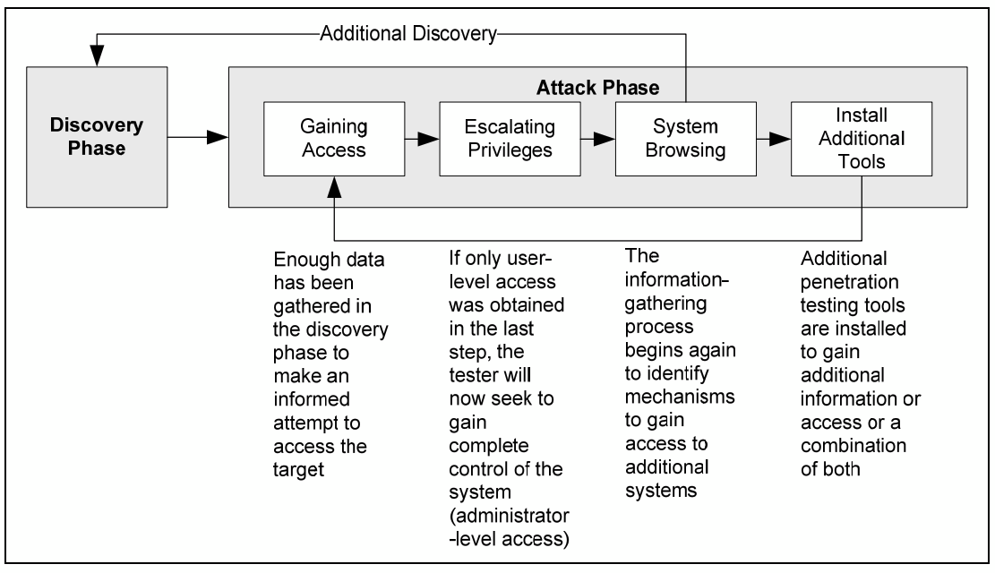
Attack phase steps

Slide 49
Most exploited vulnerabilities categories
by penetration testing
Misconfiguration
Kernel flow
Buffer overflow
Insufficient input validation
Symbolic links
File descriptor attacks
Race conditions
Incorrect file and directory permissions

Slide 50
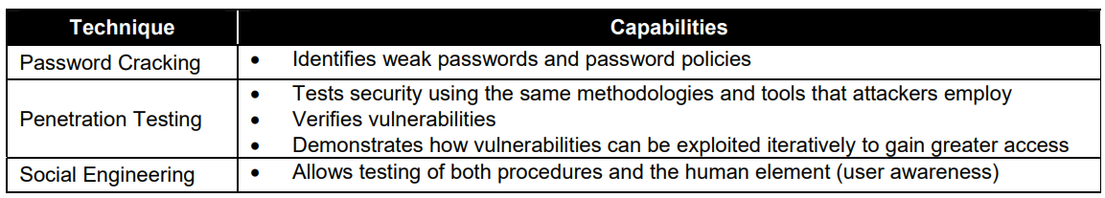
What penetration testing is not
Password cracking
Social engineering
Target vulnerability validation techniques summary

Slide 51
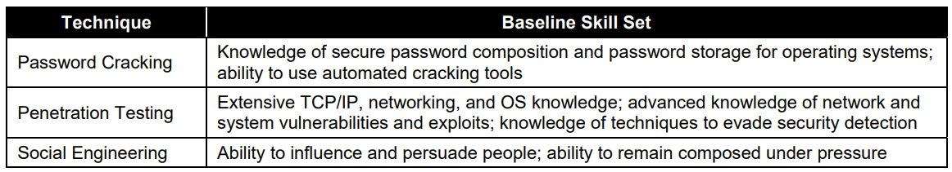
What penetration testing is not
Password cracking
Social engineering
Security testing knowledge, skills, and abilities summary

Slide 52

Thank you
Please send all questions to:
dpolemi@unipi.gr
sioannidis@tuc.gr
info@cyberhot.eu

